Slide 1

STATS 432 Computational Statistics
Chapter 9 – Metropolis Hastings Algorithm

Slide 2

9.1 – Monte Carlo Integration

Slide 3
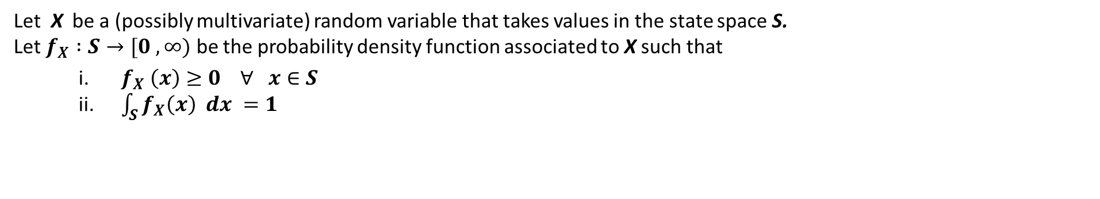

9.1a – Monte Carlo Integration:
9.1 – Monte Carlo Integration
Let X be a (possibly multivariate) random variable that takes values in the state space S.
Let $f_{X} :S→[0 , ∞)$ be the probability density function associated to X such that
$f_{X} \left(x\right)≥0 ∀ x∈S$
$\int_{S}{f_{X}\left(x\right) dx =1}$
We define the expectation of a function g of the random variable X such that
$$E_{f}\left[ g\left(X\right) \right] ≡ \int_{S}{g\left(x\right) f_{X}\left(x\right) dx}$$
This is a probability weighted average of the outcomes of X under the image of g.
(1)
Calculation of expectation values / integrals of the form described by equation (1) are useful in many fields (e.g. quantum mechanics, physical chemistry, economics). However, they may be intractable (too difficult / impossible to solve analytically).
In such instances, we may turn to Monte Carlo integration to help us approximate the integral.
3

Slide 4
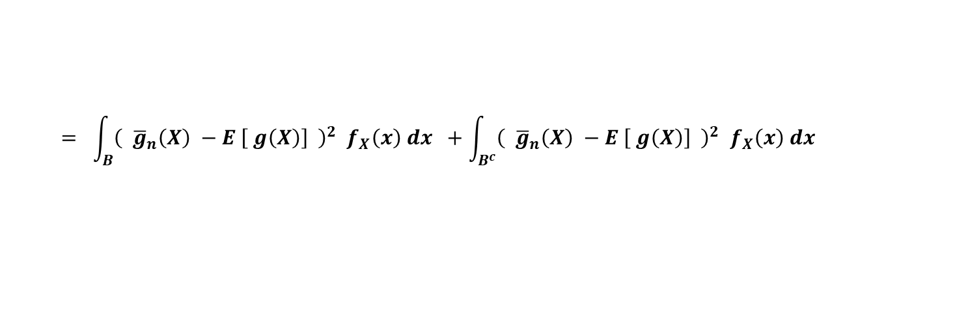
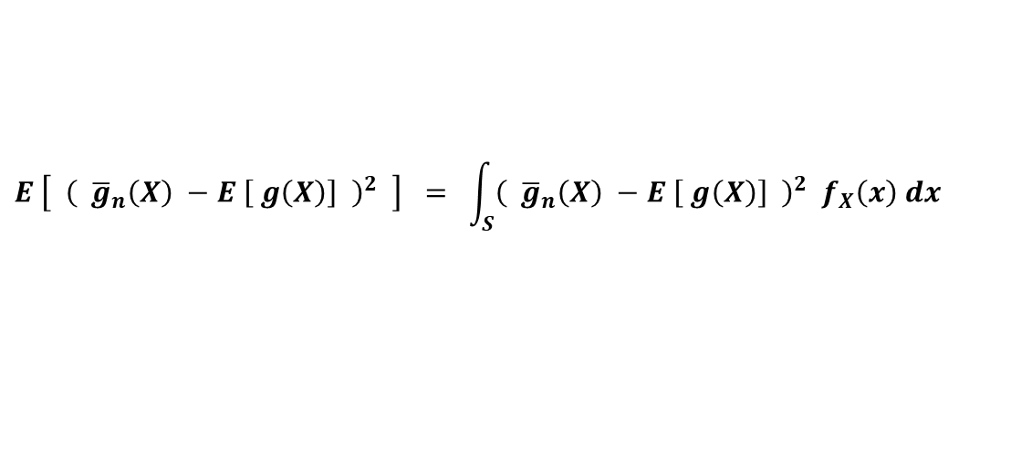
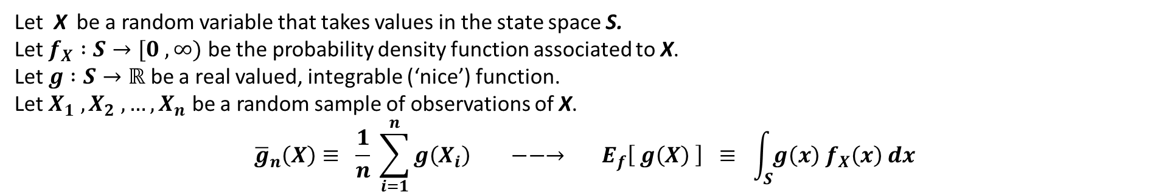

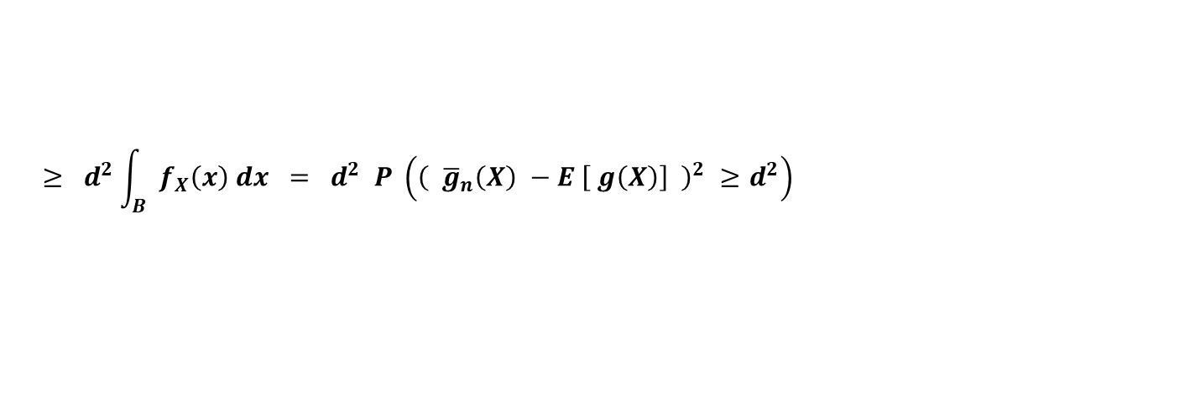
9.1b – The Ergodic Theorem:
9.1 – Monte Carlo Integration
Theorem:
Let X be a random variable that takes values in the state space S.
Let $f_{X} :S→[0 , ∞)$ be the probability density function associated to X.
Let $g :S→ℝ$ be a real valued, integrable (‘nice’) function.
Let $X_{1} , X_{2} , …, X_{n}$ be a random sample of observations of X.
$${\overline{g}}_{n}\left(X\right)≡ \frac{1}{n} \sum_{i=1}^{n}{g\left(X_{i}\right)} −−→ E_{f}\left[ g\left(X\right) \right] ≡ \int_{S}{g\left(x\right) f_{X}\left(x\right) dx}$$
almost surely
$$n→∞$$
Proof:
$$E\left[ {\overline{g}}_{n}\left(X\right) \right] = E \left[\frac{1}{n} \sum_{i=1}^{n}{g\left(X_{i}\right)}\right] = \frac{n}{n} E \left[ g\left(X\right) \right] =E \left[ g\left(X\right) \right]$$
First note that:
(A)
Next, for $d>0$ let $B= \left\{ x∈S | {\left( {\overline{g}}_{n}\left(X\right) −E \left[ g\left(X\right)\right] \right)}^{2} ≥d^{2}\right\}$
$$E \left[ {\left( {\overline{g}}_{n}\left(X\right) −E \left[ g\left(X\right)\right] \right)}^{2} \right] = \int_{S}{{\left( {\overline{g}}_{n}\left(X\right) −E \left[ g\left(X\right)\right] \right)}^{2} f_{X}\left(x\right) dx}$$
$$= \int_{B}{{\left( {\overline{g}}_{n}\left(X\right) −E \left[ g\left(X\right)\right] \right)}^{2} f_{X}\left(x\right) dx} +\int_{B^{c}}{{\left( {\overline{g}}_{n}\left(X\right) −E \left[ g\left(X\right)\right] \right)}^{2} f_{X}\left(x\right) dx}$$
$$≥ d^{2}\int_{B}{ f_{X}\left(x\right) dx} = d^{2} P \left({\left( {\overline{g}}_{n}\left(X\right) −E \left[ g\left(X\right)\right] \right)}^{2} ≥d^{2}\right)$$
4

Slide 5

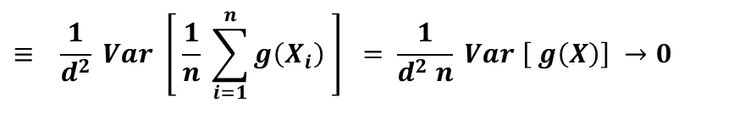


9.1b – The Ergodic Theorem:
9.1 – Monte Carlo Integration
Rearranging the last line gives
$$P \left({\left( {\overline{g}}_{n}\left(X\right) −E \left[ g\left(X\right)\right] \right)}^{2} ≥d^{2}\right) ≤ \frac{1}{d^{2}} E \left[ {\left( {\overline{g}}_{n}\left(X\right) −E \left[ g\left(X\right)\right] \right)}^{2} \right]$$
$$= \frac{1}{d^{2}} E \left[ {\left( {\overline{g}}_{n}\left(X\right) −E \left[{ \overline{g}}_{n}\left(X\right) \right] \right)}^{2} \right]$$
From (A)
$$= \frac{1}{d^{2}} Var \left[ {\overline{g}}_{n}\left(X\right) \right]$$
$$≡ \frac{1}{d^{2}} Var \left[ \frac{1}{n} \sum_{i=1}^{n}{g\left(X_{i}\right)} \right] = \frac{1}{d^{2} n} Var \left[ g\left(X\right)\right] →0$$
as $n→∞$
(B)
$$⇒P \left( \left| {\overline{g}}_{n}\left(X\right) −E \left[ g\left(X\right)\right] \right| ≥ d \right) = P \left({\left( {\overline{g}}_{n}\left(X\right) −E \left[ g\left(X\right)\right] \right)}^{2} ≥d^{2}\right) ≤ \frac{1}{d^{2} n} Var \left[ g\left(X\right)\right] →0$$
From (B)
Since $d$ can be made arbitrarily small this completes the proof.
5

Slide 6
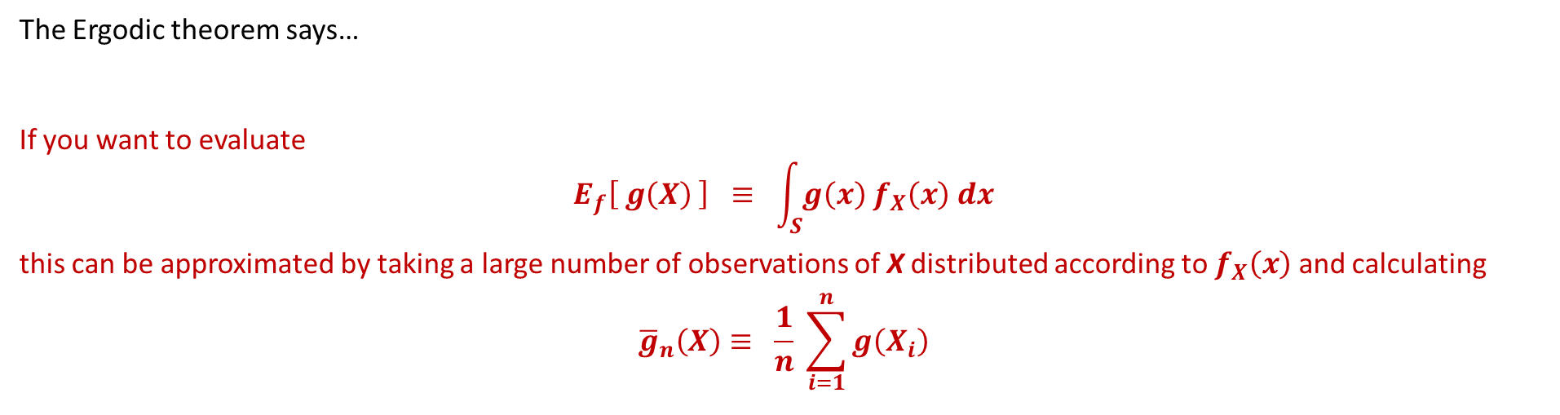
9.1b – The Ergodic Theorem:
9.1 – Monte Carlo Integration
The Ergodic theorem says…
If you want to evaluate
$$E_{f}\left[ g\left(X\right) \right] ≡ \int_{S}{g\left(x\right) f_{X}\left(x\right) dx}$$
this can be approximated by taking a large number of observations of X distributed according to $f_{X}\left(x\right)$ and calculating
$${\overline{g}}_{n}\left(X\right)≡ \frac{1}{n} \sum_{i=1}^{n}{g\left(X_{i}\right)}$$
To obtain a large number of observations of X distributed according to $f_{X}\left(x\right)$
we will use the convergence properties of Markov chains.
6

Slide 7
9.2 – The Metropolis Hastings Algorithm

Slide 8

9.2a – Markov Chain Monte Carlo:
9.2 – The MH Algorithm
Suppose that in order to approximate the integral $E_{π}\left[ g\left(X\right) \right] ≡ \int_{S}{g\left(x\right) π_{X}\left(x\right) dx}$
you wish to obtain a sequence of observations of X distributed according to $π$.
The idea of Markov Chain Monte Carlo is to construct an irreducible, ergodic (positive recurrent and aperiodic) continuous state space Markov chain ${\left\{X^{\left(t\right)}\right\}}_{t=0}^{∞}$ that has limiting distribution $π$ such that
$$k^{\left(n\right)}\left(x,y\right) →{π(y)} as n→∞.$$
Recall Theorem 8 of the chapter on ‘Markov Chains’
Hence, after a sufficiently large number of transitions (say t = N),
observations drawn from ${\left\{X^{\left(t\right)}\right\}}_{t=N}^{∞}$ will be distributed according to $π$.
The Metropolis-Hastings algorithm is one class of Markov Chain Monte Carlo algorithms that facilitates the above.
8

Slide 9
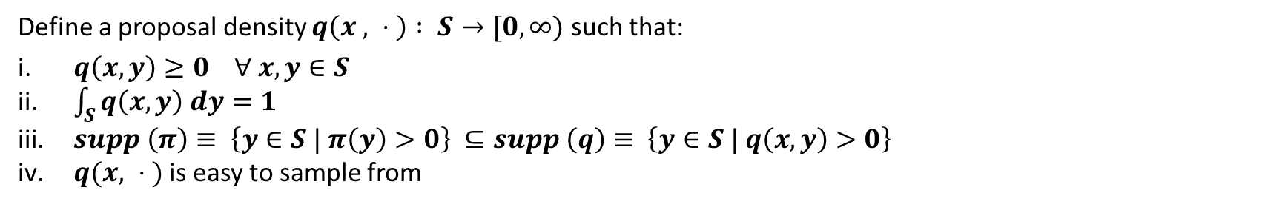
9.2b – Description of the MH Algorithm:
9.2 – The MH Algorithm
The Metropolis-Hastings algorithm proceeds according to the following steps.
Step 1:
Define the target distribution $π :S→[0, ∞)$
Step 2:
Define a proposal density $q\left(x , ⋅ \right) : S→[0, ∞)$ such that:
$q\left(x, y\right)≥0 ∀ x,y∈S$
$\int_{S}{q\left(x, y\right) dy=1}$
$supp \left(π\right)≡ \left\{y∈S | π\left(y\right)>0\right\} ⊆supp \left(q\right)≡ \left\{y∈S | q\left(x,y\right)>0\right\}$
$q(x, ⋅ )$ is easy to sample from
Step 3:
Initialise the chain by setting $X^{\left(0\right)}=x_{0}∈supp (π)$
9

Slide 10
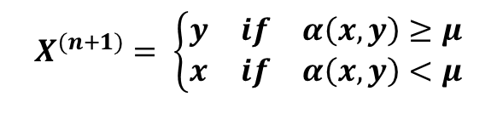

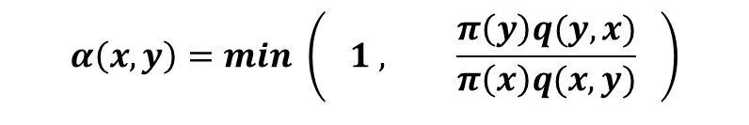
9.2b – Description of the MH Algorithm:
9.2 – The MH Algorithm
For n = 1, 2, … , k (large) repeat Step 4a & 4b shown below:
Step 4a:
Proposal Stage
Suppose that $X^{(n)}=x$
Propose a new state $y∈S$ where $y$ is drawn from $q(x,y)$
acceptance ratio (r)
Step 4b:
Acceptance Stage
$$α\left(x,y\right)=min \left( 1 , \frac{π\left(y\right)q(y,x)}{π\left(x\right)q(x,y)} \right)$$
Define the acceptance probability
Define $μ \sim U[0,1]$
Define
$$X^{(n+1)}= \left\{\begin{matrix}y & if & α\left(x,y\right)≥μ \\ x & if & α\left(x, y\right)<μ\end{matrix}\right.$$
In essence, in the Acceptance Stage we accept a transition from state $x$ to state $y$ with probability $α\left(x,y\right)$. Otherwise the chain remains at state $x$.
10

Slide 11


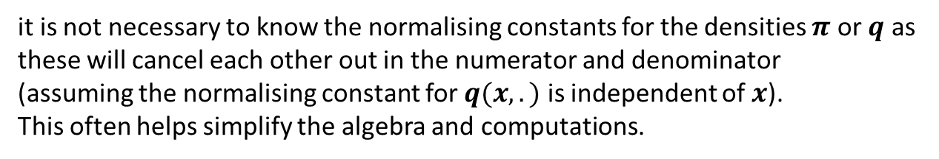
9.2c – Acceptance Rates
9.2 – The MH Algorithm
Looking at the acceptance ratio
it is not necessary to know the normalising constants for the densities $π$ or $q$ as these will cancel each other out in the numerator and denominator (assuming the normalising constant for $q(x, . )$ is independent of $x$). This often helps simplify the algebra and computations.
$$r= \frac{π\left(y\right) q(y,x)}{π\left(x\right) q(x,y)}$$
We define the acceptance rate as the proportion of times the proposed state $y$ is accepted, i.e.
$\overline{a}= \frac{1}{T} \sum_{t=1}^{T}{a_{t}}$ where $a_{t} = \left\{\begin{matrix}1 & if & y is accepted \\ 0 & if & y is rejected\end{matrix}\right.$
For Metropolis-Hastings algorithms with symmetric proposal densities and d-dimensional target distributions with i.i.d components, it has been shown theoretically that the asymptotic ($d→∞$) optimum acceptance rate is 23.4%. The optimum acceptance rate for a univariate ($d=1$) normal distribution target density is 50%.
For the purposes of Stat 432, we will want an acceptance rate somewhere between around 25% and 75%.
11

Slide 12
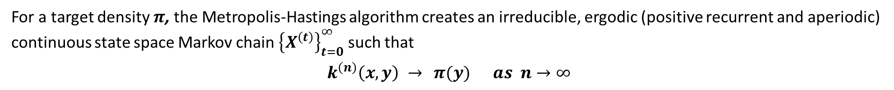
9.2d – Convergence & Burn in:
9.2 – The MH Algorithm
For a target density $π$, the Metropolis-Hastings algorithm creates an irreducible, ergodic (positive recurrent and aperiodic) continuous state space Markov chain ${\left\{X^{\left(t\right)}\right\}}_{t=0}^{∞}$ such that
$$k^{\left(n\right)}\left(x,y\right) →{π(y)} as n→∞$$
Hence, after a sufficiently large number of transitions (say t = N),
observations drawn from ${\left\{X^{\left(t\right)}\right\}}_{t=N}^{∞}$ will be distributed according to $π$.
We call the early values of the chain ${\left\{X^{\left(t\right)}\right\}}_{t=0}^{N−1}$ the burn in. We disregard these early values of the chain as they have not yet converged to the targeted distribution $π$.
Unfortunately, in most cases it is impossible to determine the value of N such that we can say with certainty that $X^{(t)} \sim π$ for all $t≥N$. Typically, we assess convergence of the chain to the target density $π$ using time series plots...
12

Slide 13
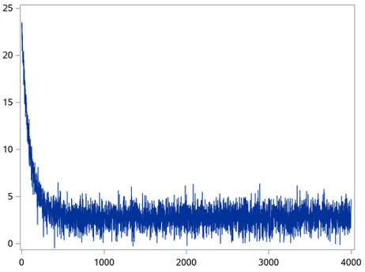

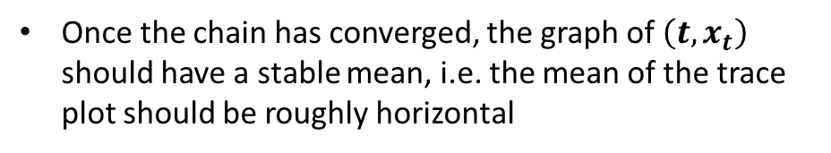
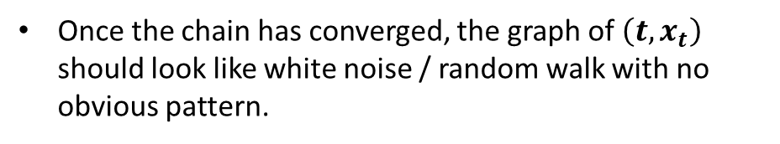

9.2d – Convergence & Burn in:
9.2 – The MH Algorithm
Time series plots visually assess convergence to the target density by plotting $\left(t, x_{t}\right)$ for t = 0, 1, 2, … , k (large)
Once the chain has converged, the graph of $\left(t, x_{t}\right)$ should look like white noise / random walk with no obvious pattern.
Burn in
$$X^{(t)} \sim π$$
Once the chain has converged, the graph of $\left(t, x_{t}\right)$ should have a stable mean, i.e. the mean of the trace plot should be roughly horizontal
$$X^{(t)}$$
Don’t be afraid to have a large burn-in (i.e. to throw away a large number of observations from earlier on in the chain).
It is better to have a smaller number of observations that follow the target distribution than a large number of observations that don’t!
Transitions (t)
13

Slide 14
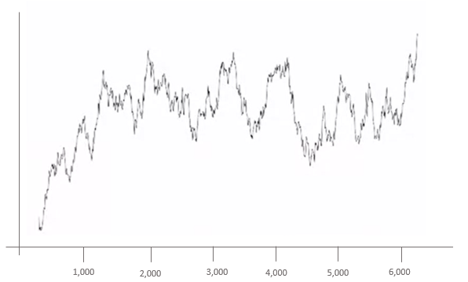
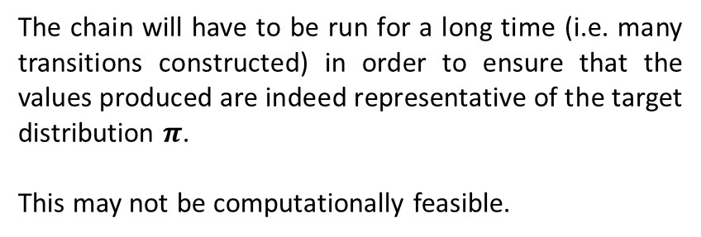

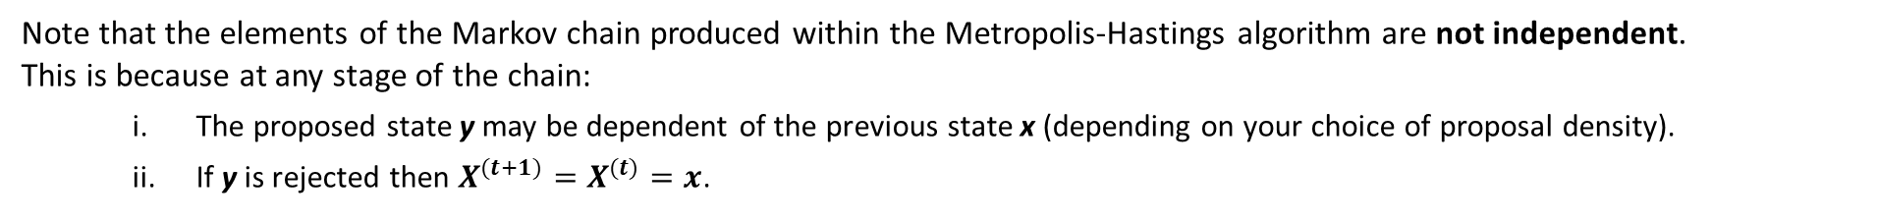
9.2e – Mixing of the Chain
9.2 – The MH Algorithm
Note that the elements of the Markov chain produced within the Metropolis-Hastings algorithm are not independent.
This is because at any stage of the chain:
The proposed state y may be dependent of the previous state x (depending on your choice of proposal density).
If y is rejected then $X^{(t+1)}=X^{(t)}=x$.
Consequently, even when a chain has converged to the target distribution it may exhibit slow mixing.
This occurs when the chain moves slowly around the support of the target distribution $π$, returning to the same region of the distribution only after a large number of transitions. In such instances, the graph of $\left(t, x_{t}\right)$ will show long term trends.
The chain will have to be run for a long time (i.e. many transitions constructed) in order to ensure that the values produced are indeed representative of the target distribution $π$.
This may not be computationally feasible.
Burn in
Slow Mixing
$$X^{(t)}$$
Transitions (t)
14

Slide 15
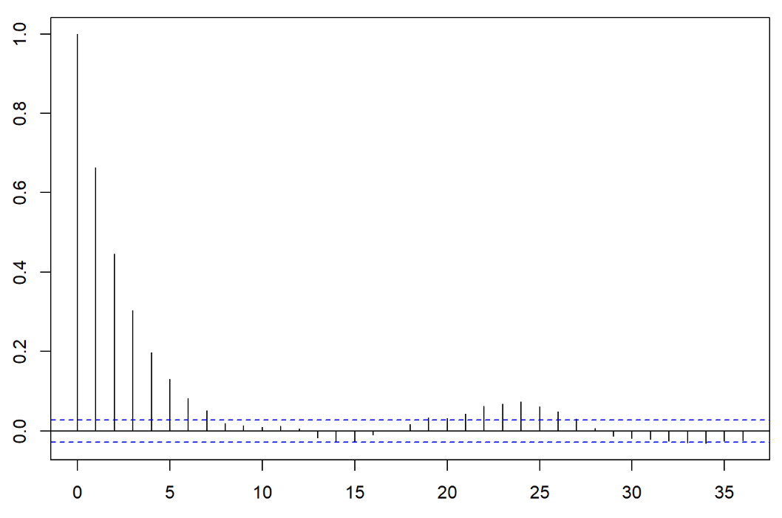
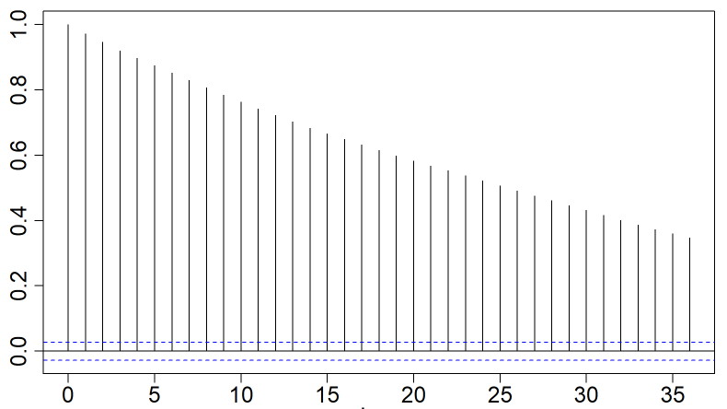
9.2e – Mixing of the Chain
9.2 – The MH Algorithm
Another way to test for slow mixing is by looking at the correlation between lagged and non-lagged values of the chain for different lag values, i.e. by plotting $corr(x_{t}, x_{t−j})$ for j = 0, 1, 2, …
Autocorrelation plots take each value of the chain and determe their level of correlation with
Elements of the chain in the previous step.
Elements of the chain two-steps previously.
Elements of the chain three-steps previously…
Quick Mixing
Slow Mixing
Correlation
Correlation
Lag
Lag
A chain which mixes quickly will exhibit low levels of correlation for high lag values
A chain which mixes slowly will exhibit high levels of correlation even for high lag values
15

Slide 16
9.3 – Simple Computational Examples of the Metropolis-Hastings Algorithm

Slide 17


9.3a – Simple Computational Example
9.3 – Simple Computational Examples
Consider the random variable $X$ defined by the probability density function
$$f_{X}(x) = \left\{\begin{matrix}A x e^{−x} & if x∈[0,100] \\ 0 & otherwise\end{matrix}\right.$$
$$A=\left(1 −101e^{−100}\right) ≈1$$
is a normalizing constant
Evaluate the integral
$$E\left[ X \right] = \int_{x=0}^{x=100}{{x f}_{X}\left(x\right) dx} = A\int_{x=0}^{x=100}{ x^{2}{ e}^{−x}} dx$$
With a little bit of algebra and using integration by parts this integral can be evaluated analytically as follows:
$$E\left[ X \right] ≈ 2.000$$
Exercise – Prove this for yourself!*
Although the integral can be calculated analytically, we will approximate it using the Metropolis-Hastings algorithm in order to illustrate the technique.
17
Associated Code = 9.3a - Computational Example of the Metropolis Hastings Algorithm

Slide 18


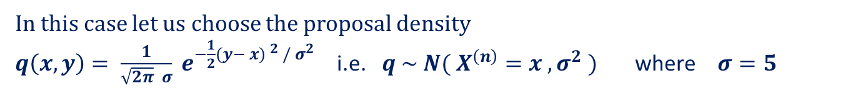
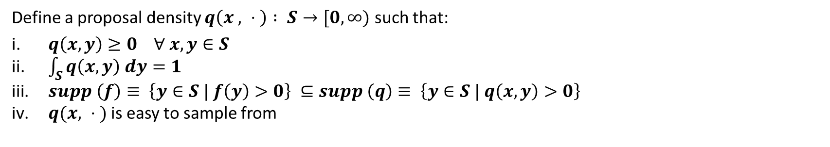
9.3a – Simple Computational Example
9.3 – Simple Computational Examples
$$f_{X}(x) = \left\{\begin{matrix}A x e^{−x} & if x∈[0,100] \\ 0 & otherwise\end{matrix}\right.$$
Step 1:
Define the target distribution $f:S→[0, ∞)$
Step 2:
Define a proposal density $q\left(x , ⋅ \right) : S→[0, ∞)$ such that:
$q\left(x, y\right)≥0 ∀ x,y∈S$
$\int_{S}{q\left(x, y\right) dy=1}$
$supp \left(f\right)≡ \left\{y∈S | f\left(y\right)>0\right\} ⊆supp \left(q\right)≡ \left\{y∈S | q\left(x,y\right)>0\right\}$
$q(x, ⋅ )$ is easy to sample from
✓
✓
✓
✓
In this case let us choose the proposal density
$q\left(x,y\right)= \frac{1}{\sqrt{2π} σ} e^{−\frac{1}{2}(y− {x) }^{2} {/ σ}^{2}}$ i.e. $q \sim N( X^{\left(n\right)}=x , σ^{2} )$ where $σ=5$
Step 3:
Initialise the chain by setting $X^{\left(0\right)}=x_{0}∈supp (f)$
Let’s set $X^{(0)}=25$
18
Associated Code = 9.3a - Computational Example of the Metropolis Hastings Algorithm

Slide 19
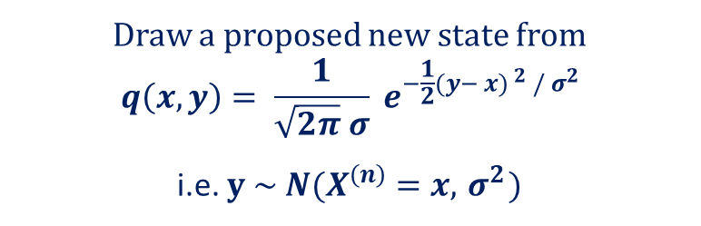
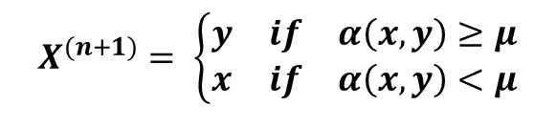

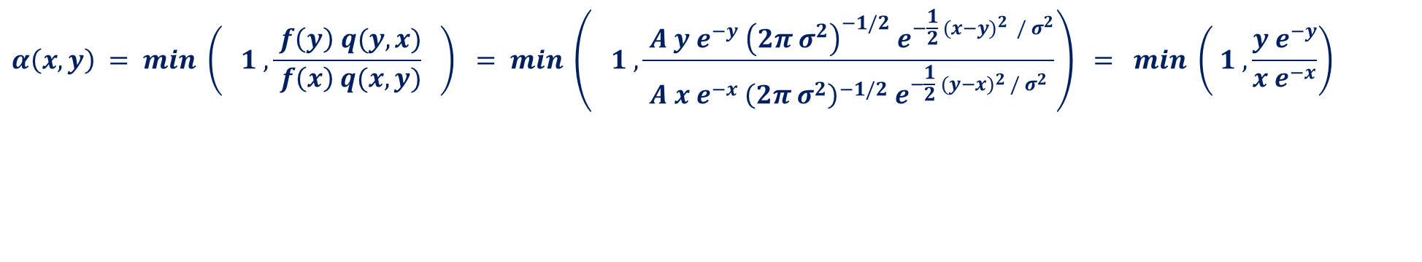
9.3a – Simple Computational Example
9.3 – Simple Computational Examples
For n = 1, 2, … , k (large) repeat Step 4a & 4b shown below:
Draw a proposed new state from
$$q\left(x,y\right)= \frac{1}{\sqrt{2π} σ} e^{−\frac{1}{2}(y− {x) }^{2} / σ^{2}}$$
i.e. $y \sim N(X^{\left(n\right)}=x, { σ}^{2})$
Step 4a:
Proposal Stage
Suppose that $X^{(n)}=x$
Propose a new state $y∈S$ where $y$ is drawn from $q(x,y)$
Step 4b:
Acceptance Stage
Define the acceptance probability
$$α\left(x,y\right) = min \left( 1 , \frac{ f\left(y\right) q(y,x)}{ f\left(x\right) q(x,y)} \right) = min \left( 1 ,\frac{ A y e^{−y}{{ \left(2π σ^{2}\right)}^{−1/2} e}^{−\frac{1}{2} (x−{y)}^{2} / σ^{2}}}{A x e^{−x}{{ \left(2π σ^{2}\right)}^{−1/2} e}^{−\frac{1}{2} (y−{x)}^{2} / σ^{2}}}\right) = min \left( 1 , \frac{y e^{−y}}{x e^{−x}}\right)$$
Define $μ \sim U[0,1]$
Define
$$X^{(n+1)}= \left\{\begin{matrix}y & if & α\left(x,y\right)≥μ \\ x & if & α\left(x, y\right)<μ\end{matrix}\right.$$
19
Associated Code = 9.3a - Computational Example of the Metropolis Hastings Algorithm

Slide 20
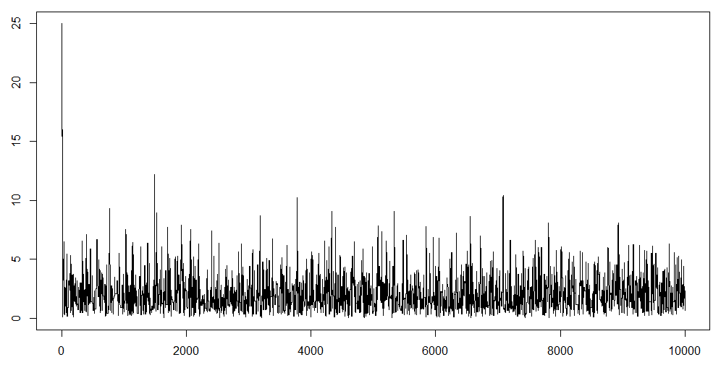
9.3a – Simple Computational Example
9.3 – Simple Computational Examples
Burn in = 1,000 iterations
9,000 iterations performed after burn in
Assumed $X^{(t)} \sim f_{X}(x)$ for all $t∈[1001, 10000]$
Burn in = 1,000
Chain converges quickly to target density
20
Associated Code = 9.3a - Computational Example of the Metropolis Hastings Algorithm

Slide 21
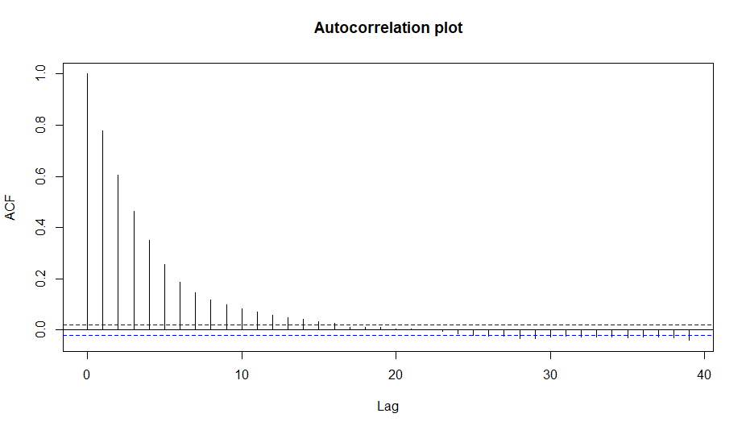
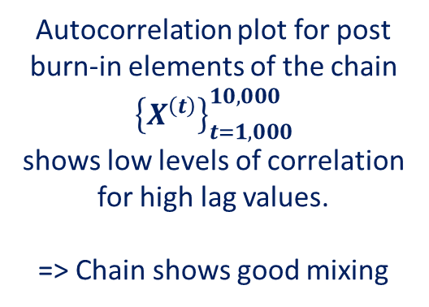
9.3a – Simple Computational Example
9.3 – Simple Computational Examples
Burn in = 1,000 iterations
9,000 iterations performed after burn in
Autocorrelation plot for post burn-in elements of the chain ${\left\{X^{\left(t\right)}\right\}}_{t=1,000}^{10,000}$
shows low levels of correlation for high lag values.
=> Chain shows good mixing
21
Associated Code = 9.3a - Computational Example of the Metropolis Hastings Algorithm

Slide 22
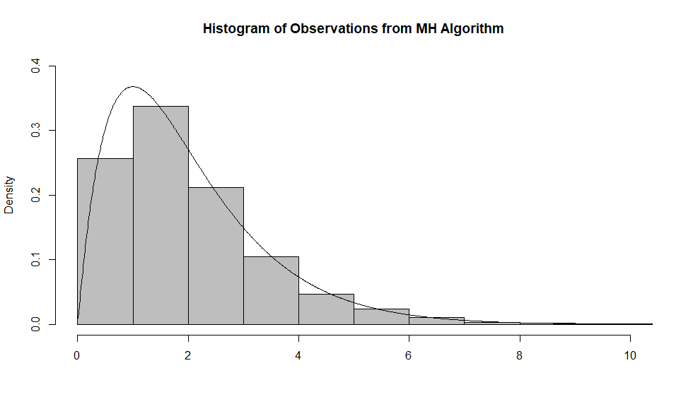
9.3a – Simple Computational Example
9.3 – Simple Computational Examples
Histogram of the observations produced by the Metropolis-Hastings algorithm in relation to the actual target distribution.
22
Associated Code = 9.3a - Computational Example of the Metropolis Hastings Algorithm

Slide 23

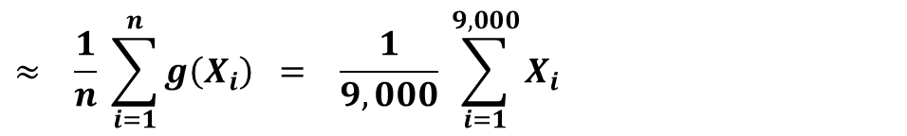
9.3a – Simple Computational Example
9.3 – Simple Computational Examples
Burn in = 1,000 iterations
9,000 iterations performed after burn in
Applying the Ergodic theorem to the 9,000 post-burn-in elements of the chain gives
$$E\left[ X \right] = \int_{x=0}^{x=100}{{x f}_{X}\left(x\right) dx} = A\int_{x=0}^{x=100}{ x^{2}{ e}^{−x}} dx$$
$$≈ \frac{1}{n} \sum_{i=1}^{n}{g\left(X_{i}\right)} = \frac{1}{9,000} \sum_{i=1}^{9,000}{X_{i}}$$
$$= 1.997814$$
This is very close to the true value of the integral $≈2$
23
Associated Code = 9.3a - Computational Example of the Metropolis Hastings Algorithm

Slide 24

9.3b – Simple Computational Example
9.3 – Simple Computational Examples
Consider the following problem:
Let $X \sim N(0,1)$ such that the probability density function associated to X is given by $f_{X}\left(x\right)= \frac{1}{√(2π)} e^{−\frac{1}{2} x^{2}}$
Let $g\left(x\right) = e^{−\frac{1}{2} {(x−3)}^{2}} + e^{−\frac{1}{2} {(x−6)}^{2}}$
Evaluate the integral
$$E\left[ g\left(x\right) \right] = \int_{R}{g\left(x\right) f_{X}\left(x\right) dx} = \int_{−∞}^{∞}{ \left( e^{−\frac{1}{2} {(x−3)}^{2}} + e^{−\frac{1}{2} {(x−6)}^{2}} \right)}\frac{1}{√(2π)} e^{−\frac{1}{2} x^{2}} dx$$
With a little bit of algebra, this integral can be evaluated analytically as follows:
$$E\left[ g\left(x\right) \right] = \frac{e^{−9/4}}{√(2π)} \int_{−∞}^{∞}{e^{−{\left(x−3/2\right)}^{2}}} dx + \frac{e^{−9}}{√(2π)} \int_{−∞}^{∞}{e^{−{\left(x−3\right)}^{2}}} dx = \frac{1}{√2} \left(e^{−9/4} +e^{−9}\right) ≈ 0.0746$$
Exercise – Prove this for yourself!
Although the integral can be calculated analytically, we will approximate it using the Metropolis-Hastings algorithm in order to illustrate the technique.
24
Associated Code = 9.3b - Computational Example of the Metropolis Hastings Algorithm

Slide 25
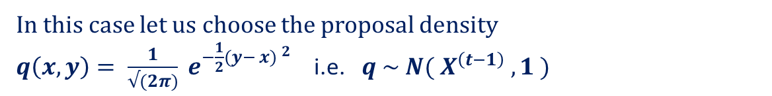

9.3b – Simple Computational Example
9.3 – Simple Computational Examples
Step 1:
Define the target distribution $f:S→[0, ∞)$
$$f_{X}\left(x\right)= \frac{1}{√(2π)} e^{−\frac{1}{2} x^{2}}$$
Step 2:
Define a proposal density $q\left(x , ⋅ \right) : S→[0, ∞)$ such that:
$q\left(x, y\right)≥0 ∀ x,y∈S$
$\int_{S}{q\left(x, y\right) dy=1}$
$supp \left(f\right)≡ \left\{y∈S | f\left(y\right)>0\right\} ⊆supp \left(q\right)≡ \left\{y∈S | q\left(x,y\right)>0\right\}$
$q(x, ⋅ )$ is easy to sample from
✓
✓
✓
✓
In this case let us choose the proposal density
$q\left(x,y\right)= \frac{1}{√(2π)} e^{−\frac{1}{2}(y− {x) }^{2}}$ i.e. $q \sim N( X^{\left(t−1\right)} , 1 )$
Step 3:
Initialise the chain by setting $X^{\left(0\right)}=x_{0}∈supp (f)$
Let’s set $X^{(0)}=20$
25
Associated Code = 9.3b - Computational Example of the Metropolis Hastings Algorithm

Slide 26
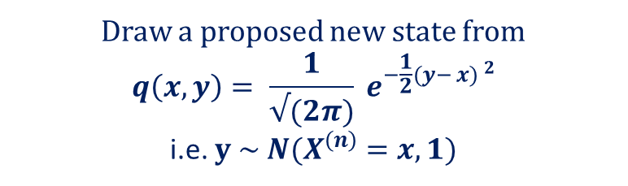
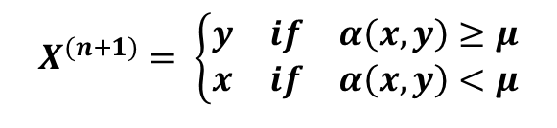

9.3b – Simple Computational Example
9.3 – Simple Computational Examples
For n = 1, 2, … , k (large) repeat Step 4a & 4b shown below:
Draw a proposed new state from
$$q\left(x,y\right)= \frac{1}{√(2π)} e^{−\frac{1}{2}(y− {x) }^{2}}$$
i.e. $y \sim N(X^{\left(n\right)}=x, 1)$
Step 4a:
Proposal Stage
Suppose that $X^{(n)}=x$
Propose a new state $y∈S$ where $y$ is drawn from $q(x,y)$
Step 4b:
Acceptance Stage
Define the acceptance probability
$$α\left(x,y\right) = min \left( 1 , \frac{ f\left(y\right)q(y,x)}{ f\left(x\right)q(x,y)} \right) = min \left( 1 ,\frac{{{\left(2π\right)}^{−1/2} e}^{−\frac{1}{2} y^{2}}{{ \left(2π\right)}^{−1/2} e}^{−\frac{1}{2} (x−{y)}^{2}}}{{{\left(2π\right)}^{−1/2} e}^{−\frac{1}{2} x^{2}}{{ \left(2π\right)}^{−1/2} e}^{−\frac{1}{2} (y−{x)}^{2}}}\right) = min \left( 1 , { e}^{−\frac{1}{2}(y^{2} −x^{2})}\right)$$
Define $μ \sim U[0,1]$
Define
$$X^{(n+1)}= \left\{\begin{matrix}y & if & α\left(x,y\right)≥μ \\ x & if & α\left(x, y\right)<μ\end{matrix}\right.$$
26
Associated Code = 9.3b - Computational Example of the Metropolis Hastings Algorithm

Slide 27
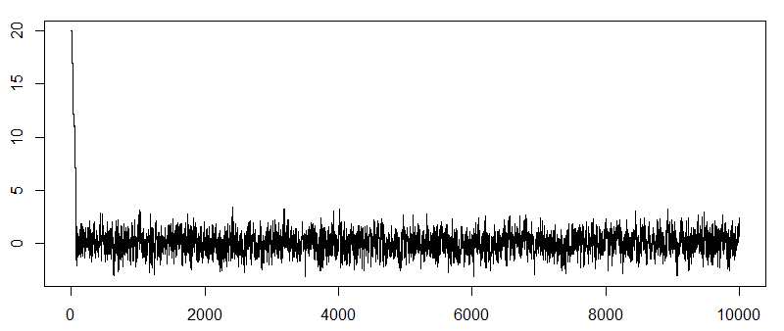
9.3b – Simple Computational Example
9.3 – Simple Computational Examples
Burn in = 1,000 iterations
9,000 iterations performed after burn in
Burn in = 1,000
Assumed $X^{(t)} \sim f_{X}(x)$ for all $t∈[1001, 10000]$
Chain converges quickly to target density
27
Associated Code = 9.3b - Computational Example of the Metropolis Hastings Algorithm

Slide 28
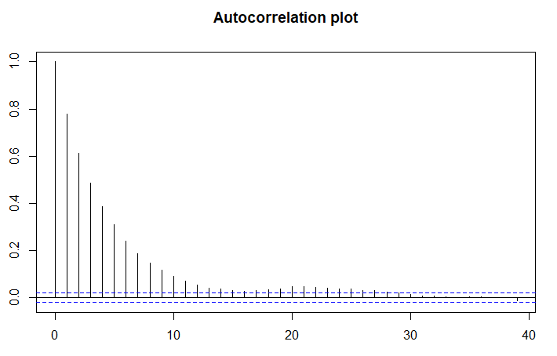
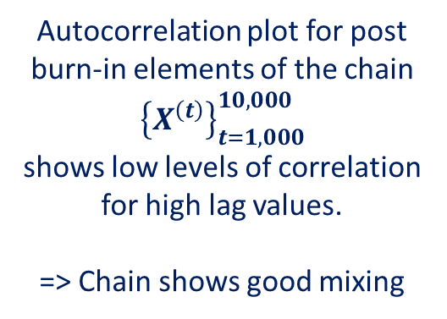
9.3b – Simple Computational Example
9.3 – Simple Computational Examples
Burn in = 1,000 iterations
9,000 iterations performed after burn in
Autocorrelation plot for post burn-in elements of the chain ${\left\{X^{\left(t\right)}\right\}}_{t=1,000}^{10,000}$
shows low levels of correlation for high lag values.
=> Chain shows good mixing
28
Associated Code = 9.3b - Computational Example of the Metropolis Hastings Algorithm

Slide 29

9.3b – Simple Computational Example
9.3 – Simple Computational Examples
Burn in = 1,000 iterations
9,000 iterations performed after burn in
Applying the Ergodic theorem to the 9,000 post-burn-in elements of the chain gives
$$E_{f}\left[ g\left(X\right) \right] ≡ \int_{S}{g\left(x\right) f_{X}\left(x\right) dx} ≈ {\overline{g}}_{9,000}\left(X\right)≡ \frac{1}{9,000} \sum_{i=1}^{9,000}{g\left(X_{i}\right)} = 0.0777$$
This is very close to the true value of the integral = 0.0746
29
Associated Code = 9.3b - Computational Example of the Metropolis Hastings Algorithm

Slide 30
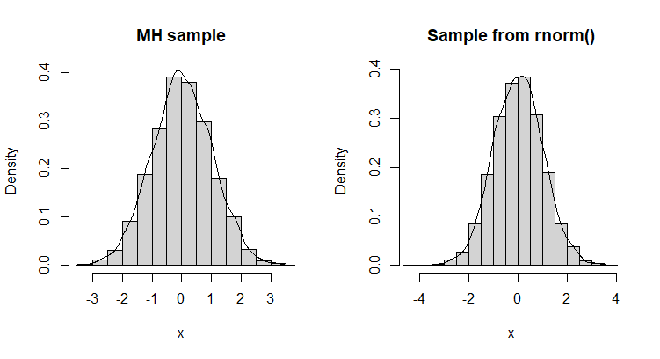
9.3b – Simple Computational Example
9.3 – Simple Computational Examples
Note that in order to approximate the desired integral in this example we used the Metropolis-Hastings algorithm to create a sample of observations from the distribution $N(0, 1)$.
How does this sample compare to a similar sample of random numbers drawn from the rnorm command?
The adjacent graphs show that the distributions of the two samples are very similar.
Indeed, applying a two-sample Kolmogorov-Smirnov test yields no evidence against the null hypothesis that the two samples arise from the same distribution.
30
Associated Code = 9.3b - Computational Example of the Metropolis Hastings Algorithm

Slide 31
9.X – Why Does the Metropolis-Hastings Algorithm Work?

Slide 32
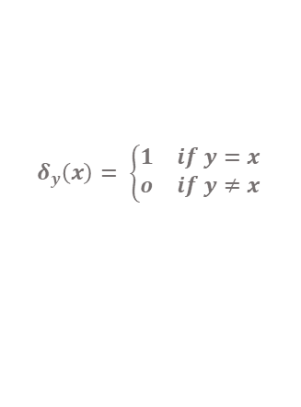
9.Xa – Why Does the MH Algorithm Work?
9.X – Why Does the MH Algorithm Work?
Here we demonstrate the Markov chain produced by the Metropolis-Hastings algorithm has limiting distribution $π$. To this end, note that the transition kernel for the chain is given by:
$$k\left(x,y\right) = q\left(x,y\right) α\left(x,y\right) + δ_{x}\left(y\right) \left(1 −\int_{S}{q\left(x,y\right) α\left(x,y\right) dy}\right)$$
Probability y
is proposed
Probability y
is accepted
$$δ_{y}\left(x\right)= \left\{\begin{matrix}1 & if y=x \\ o & if y≠x\end{matrix}\right.$$
Probability of
Remaining at x
Probability of transitioning to y
So that the probability that the chain transitions from state $x$ to the set $A⊆S$ is given by
$$P\left(x, A\right) = \int_{A}{k\left(x,y\right)}dy = \int_{A}{q\left(x,y\right) α\left(x,y\right)} dy + I\left(x∈A\right)∗ \left(1 −\int_{S}{q\left(x,y\right) α\left(x,y\right) dy}\right)$$
32

Slide 33

9.Xa – Why Does the MH Algorithm Work?
9.X – Why Does the MH Algorithm Work?
Here we demonstrate the Markov chain produced by the Metropolis-Hastings algorithm has limiting distribution $π$. To this end, note that the transition kernel for the chain is given by:
$$k\left(x,y\right) = q\left(x,y\right) α\left(x,y\right) + δ_{x}\left(y\right) \left(1 −\int_{S}{q\left(x,y\right) α\left(x,y\right) dy}\right)$$
Probability y
is proposed
Probability y
is accepted
$$δ_{y}\left(x\right)= \left\{\begin{matrix}1 & if y=x \\ o & if y≠x\end{matrix}\right.$$
Probability of
Remaining at x
Probability of transitioning to y
We want to show that the transition kernel exhibits detailed balance / reversibility with respect to the target distribution $π$ as this implies that $π$is stationary and hence limiting distribution for the chain.
33

Slide 34
9.Xa – Why Does the MH Algorithm Work?
9.X – Why Does the MH Algorithm Work?
Here we demonstrate the Markov chain produced by the Metropolis-Hastings algorithm has limiting distribution $π$. To this end, note that the transition kernel for the chain is given by:
$$k\left(x,y\right) = q\left(x,y\right) α\left(x,y\right) + δ_{x}\left(y\right) \left(1 −\int_{S}{q\left(x,y\right) α\left(x,y\right) dy}\right)$$
Probability y
is proposed
Probability y
is accepted
$$δ_{y}\left(x\right)= \left\{\begin{matrix}1 & if y=x \\ o & if y≠x\end{matrix}\right.$$
Probability of
Remaining at x
Probability of transitioning to y
If y = x it is trivially true that the detailed balance equation holds, i.e.
$$π\left(x\right)k\left(x,y\right) = π\left(y\right) k(y,x)$$
34

Slide 35
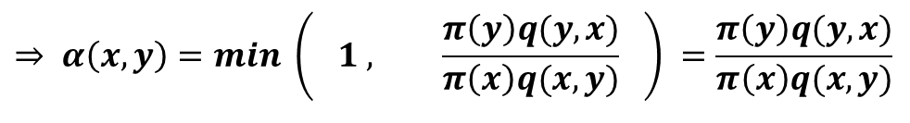

9.Xa – Why Does the MH Algorithm Work?
9.X – Why Does the MH Algorithm Work?
If $y≠x$ the transition kernel simplifies to
$$k\left(x,y\right) = q\left(x,y\right) α\left(x,y\right)$$
So if $y≠x$ and $\frac{π\left(y\right)q(y,x)}{π\left(x\right)q(x,y)}<1$
$$⇒ α\left(x,y\right)=min \left( 1 , \frac{π\left(y\right)q(y,x)}{π\left(x\right)q(x,y)} \right) =\frac{π\left(y\right)q(y,x)}{π\left(x\right)q(x,y)}$$
$$⇒π\left(x\right)q\left(x,y\right) α\left(x,y\right)=π\left(y\right)q(y,x)$$
But if $\frac{π\left(y\right)q(y,x)}{π\left(x\right)q(x,y)}<1 ⇒$ $\frac{π\left(x\right)q(x,y)}{π\left(y\right)q(y,x)} >1 ⇒ α\left(y,x\right)=min \left( 1 , \frac{π\left(x\right)q(x,y))}{π\left(y\right)q(y,x)} \right) = 1$
= 1
$$⇒π\left(x\right)q\left(x,y\right) α\left(x,y\right)=π\left(y\right)q\left(y,x\right) α\left(y,x\right)$$
$$⇒π\left(x\right)k\left(x,y\right) = π\left(y\right) k(y,x)$$
detailed balance holds
35

Slide 36

9.Xa – Why Does the MH Algorithm Work?
9.X – Why Does the MH Algorithm Work?
If $y≠x$ the transition kernel simplifies to
$$k\left(x,y\right) = q\left(x,y\right) α\left(x,y\right)$$
So if $y≠x$ and $\frac{π\left(y\right)q(y,x)}{π\left(x\right)q(x,y)}=1 ⇒ \frac{π\left(x\right)q(x,y)}{π\left(y\right)q(y,x)}=1$
$$⇒ α\left(x,y\right)=min \left( 1 , \frac{π\left(y\right)q(y,x)}{π\left(x\right)q(x,y)} \right) = 1 =min\left( 1 , \frac{π\left(x\right)q(x,y)}{π\left(y\right)q(y,x)} \right) = α(y, x)$$
= 1
= 1
$$⇒π\left(x\right)q\left(x,y\right) α\left(x,y\right)=π\left(y\right)q\left(y,x\right) α\left(y,x\right)$$
$$⇒π\left(x\right)k\left(x,y\right) = π\left(y\right) k(y,x)$$
detailed balance holds
36

Slide 37
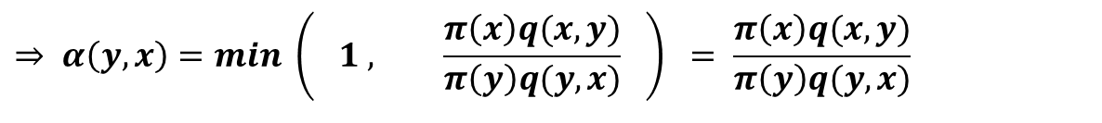

9.Xa – Why Does the MH Algorithm Work?
9.X – Why Does the MH Algorithm Work?
If $y≠x$ the transition kernel simplifies to
$$k\left(x,y\right) = q\left(x,y\right) α\left(x,y\right)$$
So if $y≠x$ and $\frac{π\left(y\right)q(y,x)}{π\left(x\right)q(x,y)}>1 ⇒ \frac{π\left(x\right)q(x,y)}{π\left(y\right)q(y,x)}<1$
$$⇒ α\left(y,x\right)=min \left( 1 , \frac{π\left(x\right)q(x,y)}{π\left(y\right)q(y,x)} \right) = \frac{π\left(x\right)q(x,y)}{π\left(y\right)q(y,x)}$$
$$⇒π\left(y\right)q\left(y,x\right) α\left(y,x\right)=π\left(x\right)q(x,y)$$
But if $\frac{π\left(y\right)q(y,x)}{π\left(x\right)q(x,y)}>1 ⇒ α\left(x,y\right)=min \left( 1 , \frac{π\left(y\right)q(y,x)}{π\left(x\right)q(x,y)} \right) = 1$
= 1
$$⇒π\left(y\right)q\left(y,x\right) α\left(y,x\right)=π\left(x\right)q\left(x,y\right) α\left(x,y\right)$$
$$⇒π\left(y\right)k\left(y,x\right) = π\left(x\right) k(x,y)$$
detailed balance holds
37

Slide 38

9.Xa – Why Does the MH Algorithm Work?
9.X – Why Does the MH Algorithm Work?
In all cases the detailed balance equation holds:
$$π\left(x\right)k\left(x,y\right) = π\left(y\right) k(y,x)$$
$$⇒ \int_{S}{π\left(x\right)k\left(x,y\right)}dx = \int_{S}{π\left(y\right) k\left(y,x\right) dx}$$
$$⇒ \int_{S}{π\left(x\right)k\left(x,y\right)}dx = π\left(y\right)\int_{S}{k\left(y,x\right) dx}$$
$$⇒ \int_{S}{π\left(x\right)k\left(x,y\right)}dx = π\left(y\right)$$
This implies that $π\left(y\right)$is a stationary and hence limiting distribution for the chain. Thus,
$$k^{\left(n\right)}\left(x,y\right) →{π(y)} as n→∞$$
as required.
38

Slide 39
9.4 – Tuning the Metropolis-Hastings Algorithm

Slide 40
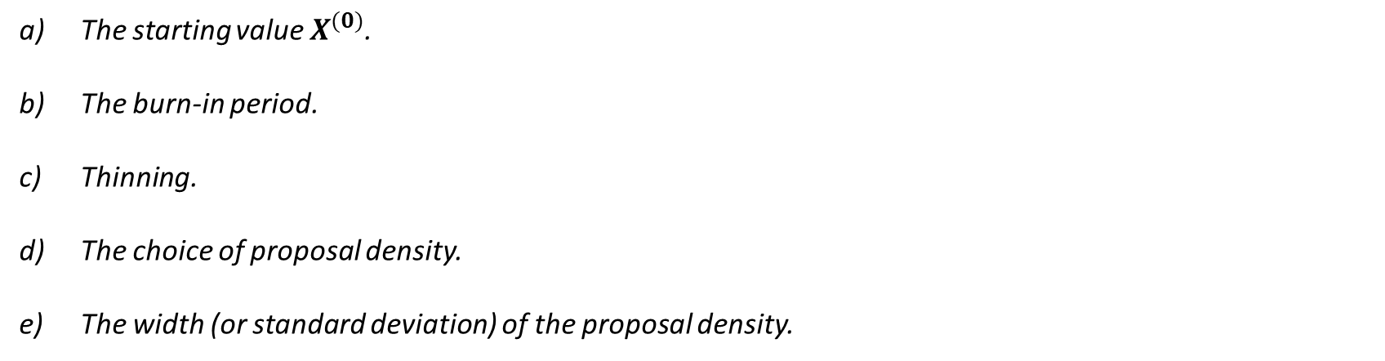
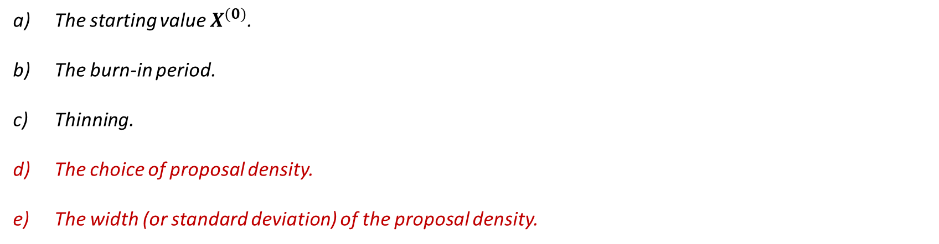
9.4 – Tuning the Algorithm:
9.4 – Tuning the MH Algorithm
Like most Markov Chain Monte Carlo methods, the Metropolis-Hastings algorithm does not tend to work well ‘straight out of the box’. In most case we must tune the algorithm by modifying one or more of the following:
The starting value $X^{(0)}$.
The burn-in period.
Thinning.
The choice of proposal density.
The width (or standard deviation) of the proposal density.
The starting value $X^{(0)}$.
The burn-in period.
Thinning.
The choice of proposal density.
The width (or standard deviation) of the proposal density.
The most important aspects to tune are those relating to the proposal density. This is because the relationship between the proposal density and the target distribution strongly affects the rate at which the chain converges.
40

Slide 41
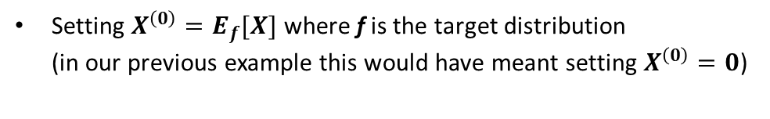

9.4a – The Starting Value $X^{(0)}$:
9.4 – Tuning the MH Algorithm
The choice of starting value can effect the speed at which the chain converges to the target distribution.
In the previous example, when using the Metropolis-Hastings algorithm to construct a sample of observations drawn from $N(0,1)$, we chose the starting value $X^{\left(0\right)}=20$. This value was chosen simply so we could visually show the chain ‘burning-in’ to target distribution.
Many adhoc methods exist for selecting $X^{\left(0\right)}$. These include:
Burn in = 1,000
Sampling directly from the target distribution
Assumed $X^{(t)} \sim N\left(0,1\right)$ for all $t∈[1001, 10000]$
Applying MLE estimates
Sampling from near a known mode of the target distribution
Setting $X^{\left(0\right)}=E_{f}[X]$ where f is the target distribution (in our previous example this would have meant setting $X^{\left(0\right)}=0$)
One strategy is to generate a number of parallel chains with different starting values, assessing whether they all converge to the same distribution, then to choose the one that converges fastest.
41

Slide 42

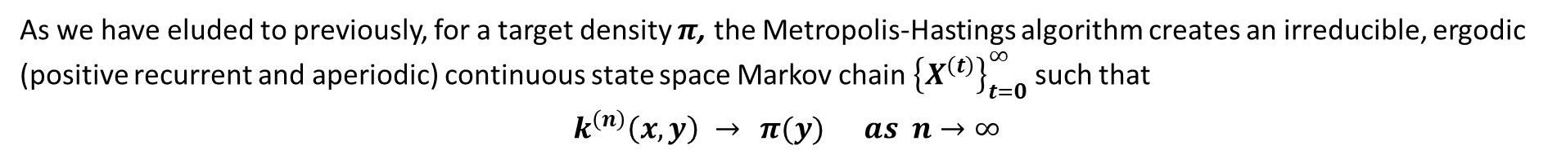
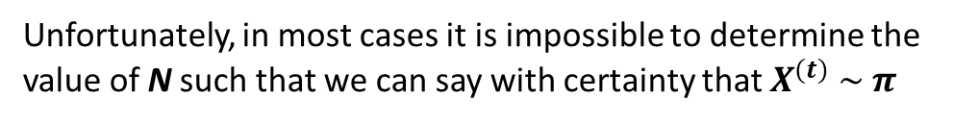

9.4b – The Burn-in:
9.4 – Tuning the MH Algorithm
As we have eluded to previously, for a target density $π$, the Metropolis-Hastings algorithm creates an irreducible, ergodic (positive recurrent and aperiodic) continuous state space Markov chain ${\left\{X^{\left(t\right)}\right\}}_{t=0}^{∞}$ such that
$$k^{\left(n\right)}\left(x,y\right) →{π(y)} as n→∞$$
After a large number of transitions (say t = N), observations drawn from ${\left\{X^{\left(t\right)}\right\}}_{t=N}^{∞}$ will be distributed according to $π$.
We call the early values of the chain ${\left\{X^{\left(t\right)}\right\}}_{t=0}^{N−1}$ the burn in. We disregard these early values of the chain as they have not yet converged to the targeted limiting distribution $π$.
Burn in
$$X^{(t)} \sim π$$
Unfortunately, in most cases it is impossible to determine the value of N such that we can say with certainty that $X^{(t)} \sim π$
As such, most Metropolis-Hastings algorithms are constructed in such a way that the user can easily discard enough early values of the chain to be reasonable certain that the chain has converged.
42

Slide 43

9.4c – Thinning:
9.4 – Tuning the MH Algorithm
If a chain mixes slowly, this may require the chain to be run for a long time (i.e. a large number of transitions constructed) in order that it traverses the state space a sufficient number of times and provides a good representation of the target distribution. If the algorithm is complex / multi-dimensional / involves multiple chains this may use up a lot of memory.
The technique of thinning, whereby only every d^{th} value of the chain (after burn-in) is retained is designed to:
Burn in
Slow Mixing
Reduce computer memory usage.
Reduce the level of auto-correlation within the chain such that the elements of the sample produced are closer to being independent.
$$X^{(t)}$$
Transitions (t)
However, this technique has come in for a lot of criticism in recent times (see here & here).
43

Slide 44
9.4c – Thinning:
9.4 – Tuning the MH Algorithm
The general argument against thinning can be expressed as follows:
Consider a chain that is strongly auto-correlated and so mixes slowly.
Auto-correlation produces ‘clumpy’ samples which, in the short run, are not representative of the target distribution.
One way to decrease this auto-correlation is to keep only every d^{th} value in the chain. If we keep 50,000 ‘thinned’ values with small auto-correlation, this gives us a better representation of the target distribution that a sample of 50,000 ‘un-thinned’ values with large auto-correlation.
The problem is… To get 50,000 ‘thinned’ values you have to generate d * 50,000 values. With such a long chain, the auto-correlation has probably been averaged out anyway.
Indeed, the longer ‘un-thinned’ chain usually yields a better representation of the target distribution than the shorter ‘thinned’ chain.
The moral of the story is… (unless memory space is a major issue) use thinning sparingly.
44

Slide 45
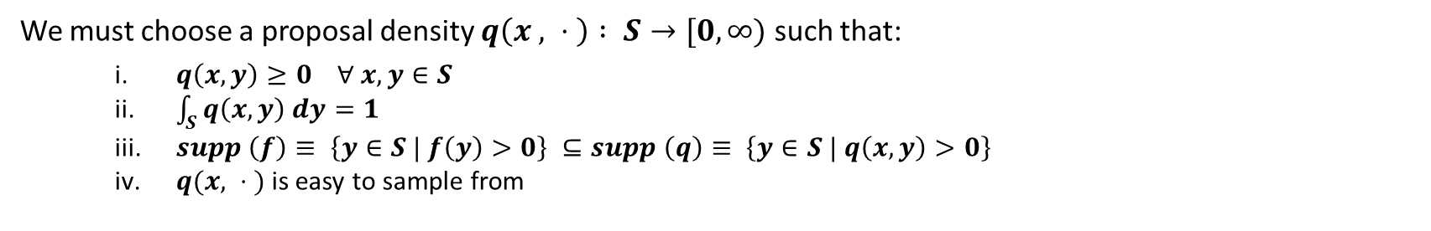
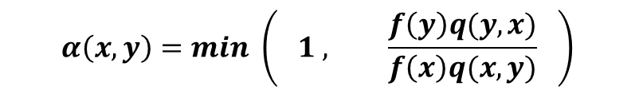
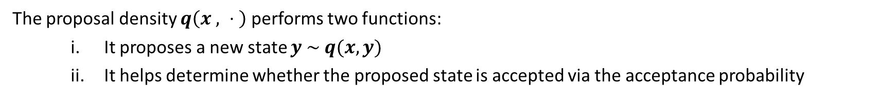
9.4d – Choice of Proposal Density:
9.4 – Tuning the MH Algorithm
The relationship between the proposal density q and the target distribution f strongly affects the rate at which the chain converges. Thus, the choice of proposal density is important.
We must choose a proposal density $q\left(x , ⋅ \right) : S→[0, ∞)$ such that:
$q\left(x, y\right)≥0 ∀ x,y∈S$
$\int_{S}{q\left(x, y\right) dy=1}$
$supp \left(f\right)≡ \left\{y∈S | f\left(y\right)>0\right\} ⊆supp \left(q\right)≡ \left\{y∈S | q\left(x,y\right)>0\right\}$
$q(x, ⋅ )$ is easy to sample from
The proposal density $q\left(x , ⋅ \right)$ performs two functions:
It proposes a new state $y \sim q(x, y)$
It helps determine whether the proposed state is accepted via the acceptance probability
$$α\left(x,y\right)=min \left( 1 , \frac{f\left(y\right)q(y,x)}{f\left(x\right)q(x,y)} \right)$$
There are two types of proposal density that occur often in practice.
45

Slide 46
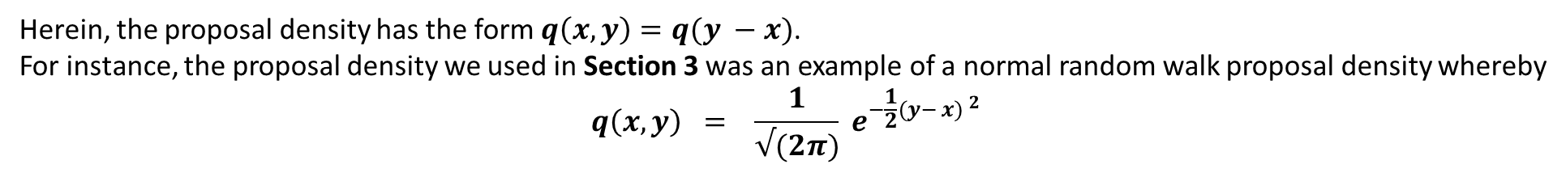
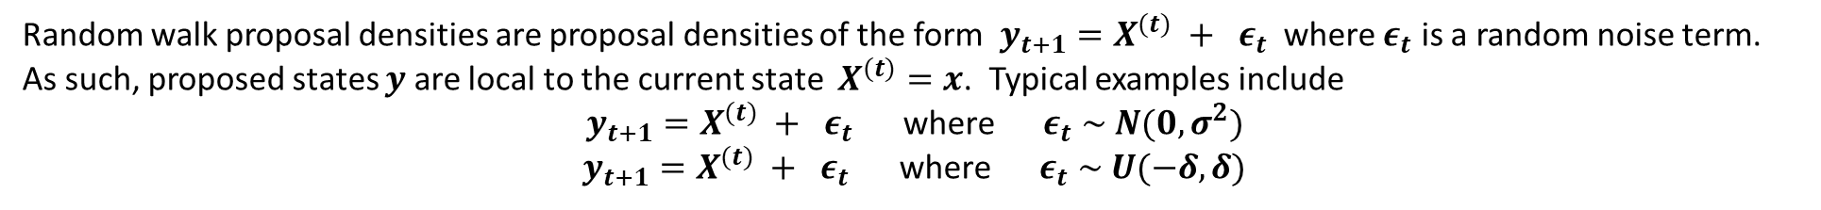
9.4d – Choice of Proposal Density:
9.4 – Tuning the MH Algorithm
Random Walk Proposal Densities:
Random walk proposal densities are proposal densities of the form $y_{t+1}=X^{(t)} + ε_{t}$ where $ε_{t}$ is a random noise term.
As such, proposed states $y$ are local to the current state $X^{(t)}=x$. Typical examples include
$y_{t+1}=X^{(t)} + ε_{t}$ where $ε_{t} \sim N(0, σ^{2})$
$y_{t+1}=X^{(t)} + ε_{t}$ where $ε_{t} \sim U(−δ,δ)$
Herein, the proposal density has the form $q\left(x,y\right)=q(y −x)$.
For instance, the proposal density we used in Section 3 was an example of a normal random walk proposal density whereby
$$q\left(x,y\right) = \frac{1}{√(2π)} e^{−\frac{1}{2}(y− {x) }^{2}}$$
If $ε_{t}$ is symmetric about zero, then proposal density q is symmetric such that $q\left(x,y\right)=q(y,x)$.
In this case the acceptance probability used in the Metropolis-Hastings algorithm simplifies to:
$$α\left(x,y\right)=min \left( 1 , \frac{f\left(y\right) q(y,x)}{f\left(x\right) q(x,y)} \right) = min \left( 1 , \frac{f\left(y\right)}{f\left(x\right)} \right)$$
Random walk proposal densities are often called Random Walk Samplers.
46
For symmetric q, the Markov chain associated with q is a random walk. However, the overall Metropolis-Hastings chain is not a random walk due to the acceptance-rejection step

Slide 47

9.4d – Choice of Proposal Density:
9.4 – Tuning the MH Algorithm
Independent Proposal Densities:
A proposal density is independent if $q\left(x,y\right)≡q\left(y \right|x)=q(y)$,
i.e. if the proposed state y has no dependence on $X^{(t)}=x$.
If the proposal density is independent then the acceptance probability simplifies to
$$α\left(x,y\right)=min \left( 1 , \frac{f\left(y\right) q(y,x)}{f\left(x\right) q(x,y)} \right) = min \left( 1 , \frac{f\left(y\right) q(x)}{f\left(x\right) q(y)} \right)$$
If we replaced the proposal density we used in Section 3 with…
i.e. proposed states are sampled from $y \sim N(0, 1)$ instead of being sampled from $$y \sim N(X^{\left(t\right)}=x, 1)$$
$$q\left(x,y\right) ≡ q\left(y\right)= \frac{1}{√(2π)} e^{−\frac{1}{2} y^{2}}$$
… this would have been an example of a normal independence sampler.
Independent proposal densities are often called independence samplers.
47

Slide 48


9.4e – The Width of the Proposal Density:
9.4 – Tuning the MH Algorithm
If the width (or standard deviation) of the proposal density is too large or too small, this will affect the rate at which the
chain converges to the target distribution and the speed at which it traverses the state space (mixes). In particular:
Proposal densities with small width will propose small changes between $X^{(t)}$ and $X^{(t+1)}$. Such chains will have high acceptance rates but will only traverse the state space slowly (slow mixing).
Proposal densities with large width will propose large changes between $X^{(t)}$ and $X^{(t+1)}$, i.e. they will often propose moves from the body of the target distribution to tails of the distribution. This will reduce auto-correlation in the chain, but low acceptance rates can again result in slow mixing.
This is best illustrated by example.
Consider the problem of generating a sample of observations from the $X \sim Beta(2,4)$ distribution
$$f_{X}\left(x\right) = \left\{\begin{matrix}\frac{Γ(a+b)}{Γ\left(a\right)Γ(b)} x^{a−1} {\left(1 −x\right)}^{b−1} & if & x∈[0,1] \\ 0 & if & x∉[0,1]\end{matrix} = \left\{\begin{matrix}20 x^{1} {\left(1 −x\right)}^{3} & if & x∈[0,1] \\ 0 & if & x∉[0,1]\end{matrix}\right.\right.$$
Here $f_{X}\left(x\right)$is our target distribution.
48
Associated Code = 9.4 – Beta Distribution (Tuning the Width of the Proposal Density)

Slide 49



9.4e – The Width of the Proposal Density:
9.4 – Tuning the MH Algorithm
For this problem we will use a random walk sampler, i.e. proposed states will be generated according to…
$y_{t+1}=X^{(t)} + ε_{t}$ where $ε_{t} \sim N(0, σ^{2})$ such that $q\left(x,y\right) = \frac{1}{{\left(2π\right)}^{1/2} σ} e^{−\frac{1}{2} (y− {x) }^{2} / σ^{2}}$
We will investigate the effects of setting…
$σ =0.01$ $σ =10$ $σ =0.5$
… on the rate at which the chain converges to the target distribution and on how well it mixes.
Note that since is $ε_{t}$ is symmetric about zero, the proposal density is also symmetric since
$$q\left(x,y\right) = \frac{1}{{\left(2π\right)}^{1/2} σ} e^{−\frac{1}{2} (y− {x) }^{2} / σ^{2}} = \frac{1}{{\left(2π\right)}^{1/2} σ} e^{−\frac{1}{2} (x− {y) }^{2} / σ^{2}} = q(y,x)$$
As such, the acceptance probability simplifies to
$$α\left(x,y\right)=min \left( 1 , \frac{f\left(y\right) q(y,x)}{f\left(x\right) q(x,y)} \right) = min \left( 1 , \frac{f\left(y\right)}{f\left(x\right)} \right)$$
The dbeta(x,a,b) command in R can be used to easily obtain the value of $f\left(x\right)$ and hence the quotient $\frac{f\left(y\right)}{f(x)}$.
49
Associated Code = 9.4 – Beta Distribution (Tuning the Width of the Proposal Density)

Slide 50




9.4e – The Width of the Proposal Density:
9.4 – Tuning the MH Algorithm
Setting $σ=0.01$
Acceptance rate = 98% (very high).
Chain makes small steps => Slow mixing
High level of autocorrelation even for high lag values
Sample of observations produced from the last 5,000 iterations of the chain is not a good representation of the beta(2,4) distribution.
50
Associated Code = 9.4 – Beta Distribution (Tuning the Width of the Proposal Density)

Slide 51




9.4e – The Width of the Proposal Density:
9.4 – Tuning the MH Algorithm
Setting $σ=10$
Acceptance rate = 2% (very low).
Chain stationary for long periods then makes large jumps from body of the target distribution to the tails.
High level of autocorrelation even for high lag values
Sample of observations produced from the last 5,000 iterations of the chain is not a good representation of the beta(2,4) distribution.
51
Associated Code = 9.4 – Beta Distribution (Tuning the Width of the Proposal Density)

Slide 52




9.4e – The Width of the Proposal Density:
9.4 – Tuning the MH Algorithm
Setting $σ=0.5$
Acceptance rate = 40% (good).
Chain converges quickly, traverses state space quickly
Low level of autocorrelation for high lag values
Sample of observations produced from the last 5,000 iterations of the chain is a decent representation of the beta(2,4) distribution.
52
Associated Code = 9.4 – Beta Distribution (Tuning the Width of the Proposal Density)

Slide 53
9.5 – Further Computational Examples

Slide 54

9.5 – Further Computational Examples:
9.5 – Further computational Examples
In Section 9.4e we used a normal random walk sampler to generate sampled observations from a Beta(2,4) distribution which has the following pdf
$$f_{X}\left(x\right) =\left\{\begin{matrix}20 x^{1} {\left(1 −x\right)}^{3} & if & x∈[0,1] \\ 0 & if & x∉[0,1]\end{matrix}\right.$$
In this section we will generate sampled observations from the same distribution but using:
A uniform random walk sampler.
A uniform independence sampler.
Associated Code = 9.5a – Beta Distribution (RW with Uniform Proposal Density)
54
Associated Code = 9.5b – Beta Distribution (Independence Sampler Uniform Proposal Density)

Slide 55



9.5a – Uniform Random Walk Sampler:
9.5 – Further computational Examples
In this example proposed states will be generated according to…
$y_{t+1}=X^{(t)} + ε_{t}$ where $ε_{t} \sim U\left[{−d}/2 ,d/2\right]$ such that $q\left(x,y\right) = \frac{1}{d}$
Note that since is $ε_{t}$ is symmetric about zero, the proposal density is also symmetric since
$$q\left(x,y\right) = \frac{1}{d} = q(y,x)$$
As such, the acceptance probability simplifies to
$$α\left(x,y\right)=min \left( 1 , \frac{f\left(y\right) q(y,x)}{f\left(x\right) q(x,y)} \right) = min \left( 1 , \frac{f\left(y\right)}{f\left(x\right)} \right)$$
55
Associated Code = 9.5a – Beta Distribution (RW with Uniform Proposal Density)

Slide 56




9.5a – Uniform Random Walk Sampler:
9.5 – Further computational Examples
Setting $d=1$
Acceptance rate = 53% (good).
Chain converges quickly, traverses state space quickly
Low level of autocorrelation for high lag values
Sample of observations produced from the last 5,000 iterations of the chain is a decent representation of the beta(2,4) distribution.
56
Associated Code = 9.5a – Beta Distribution (RW with Uniform Proposal Density)

Slide 57


9.5b – Uniform Independence Sampler:
9.5 – Further computational Examples
As in rejection sampling, it is important that the tails of the proposal density dominate those of the target distribution.
For target distributions where $S=[0,1]$ we can generate proposals from $U\left[0,1\right].$
Proposal densities for independence samplers don’t need to be uniform, but they do need to be able to generate proposals from the entire range of the target distribution.
In this example proposed states will be uniformly generated over the interval [0,1], i.e.
$y_{t+1} \sim U\left[0 ,1 \right]$ such that $q\left(x,y\right) = q\left(y\right) = 1$
Note that (in this case), the proposal density is also symmetric since
$$q\left(x,y\right) = 1 = q(y,x)$$
As such, the acceptance probability simplifies to
$$α\left(x,y\right)=min \left( 1 , \frac{f\left(y\right) q(y,x)}{f\left(x\right) q(x,y)} \right) = min \left( 1 , \frac{f\left(y\right)}{f\left(x\right)} \right)$$
57
Associated Code = 9.5b – Beta Distribution (Independence Sampler Uniform Proposal Density)

Slide 58



9.5b – Uniform Independence Sampler:
9.5 – Further computational Examples
Acceptance rate = 56% (good).
Chain converges quickly, traverses state space quickly
Low level of autocorrelation for high lag values
Sample of observations produced from the last 5,000 iterations of the chain is a decent representation of the beta(2,4) distribution.
58
Associated Code = 9.5b – Beta Distribution (Independence Sampler Uniform Proposal Density)

